Slide 1
Group 24 - Momentum Strategy
Eric Liang, Gary Qu, Mark Vu

Slide 2
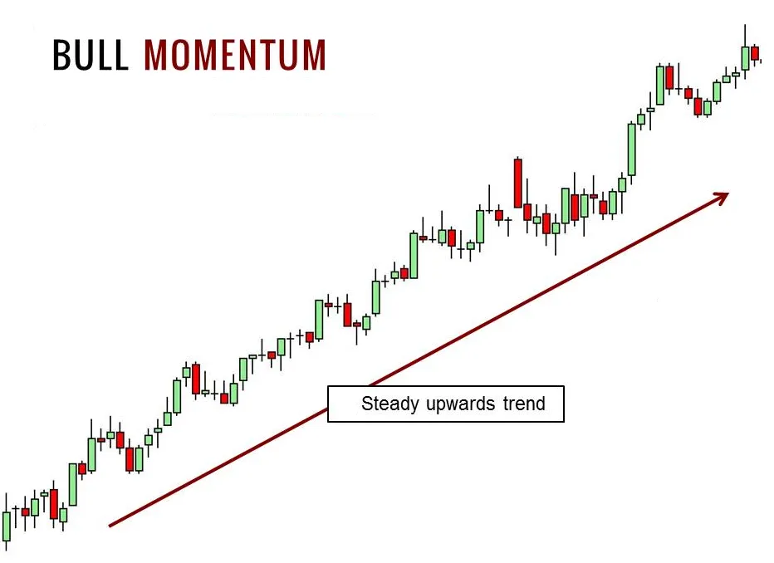
Motivation
To investigate the profitability of a momentum strategy
Research paper was based on Swedish market
Now apply on subset of stocks in the US market
Test the hypothesis of trend-following market behavior
Rank returns based on observation period performance
Pick top performers as winners and worst as losers
Assume stocks maintain historical return patterns
Long winners and short losers
Identify any systematic pattern for profitability
Figure 1: Example of Bull momentum [1]
Notes:
The main motivation for our strategy is to investigate the profitability of the momentum strategy. This strategy was based on the paper: The Momentum Effect: Evidence from the Swedish stock market, by Marcus Vilbern. In the original paper the strategy was deployed and tested out in the swedish market. In our project, we would like to apply the similar methodology in a subset of stocks in the US market. In particular, we would like to test the hypothesis that the market is trend-following. In this strategy, we will rank stock returns based on performance in an observation period, and then the top performers will be picked as winners and the worst as losers. This strategy is based on the assumption that stocks will maintain historical return patterns. Therefore, we will go long on the winner stocks and go short on the loser stocks, and see if we can identify any systematic pattern for profitability

Slide 3
Market Microstructure
Market Friction
Accounts for commission, short sale borrowing, bid-ask spreads etc.
Predefine certain % of notional amount per order
Information and disclosure
Publicly available for all market participants
No excess return should be generated under efficient market condition
Basic structure
Consider liquid stocks to avoid overrepresentation of volatile stock
Submit market order for portfolio rebalancing
Notes:
The market microstructure involved in our setting is pretty basic. In our strategy, we consider some forms of market friction, accounting for commission, short sale borrowing cost, bid-ask spreads and other expenses. We cater this aspect by predefining certain % notional amount per order. In terms of information and disclosure, all the information we have on hand are publicly available for all market participants. Therefore, under the efficient market theory there should not be any excess return that can we can exploit, but several research papers have indeed found evidence that there is profitability. In our strategy, we only consider liquid stocks to avoid any overrepresentation of volatile small cap stock. During portfolio rebalancing, trades are assumed to be executed by market orders to keep the simplicity

Slide 4
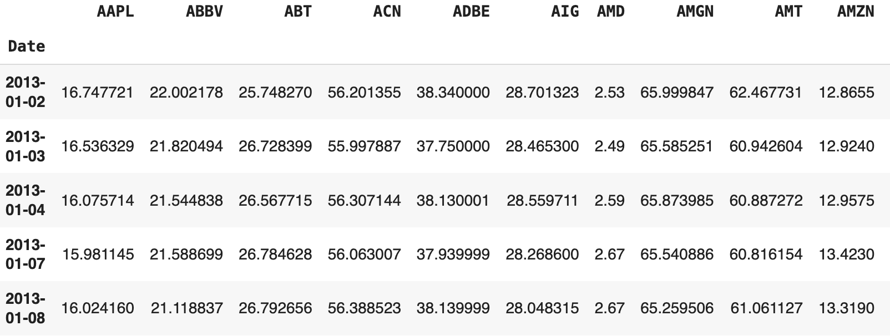
Data Acquisition and Preprocessing
Data acquisition
Sourced from Yahoo Finance API
Use daily adjusted closing price to account for stock splits and dividends
Market index - S&P 100
Each constituent stock in the index
Data preprocessing
Remove class B share tickers if both classes present due to lower liquidity
Table 1: Daily Closing Price for each stock
Notes:
The data involved in our strategy is pretty straightforward, sourced directly from yahoo finance. We utilized the daily adjusted closing price to account for stock splits and dividends, we have selected the stocks within the universe of the S&P100 index as they represent some of the most liquid stocks with large market cap. Before implementing our strategy, we have removed any class B share tickers within the list if both classes are present. The table below demonstrates how our data look like.

Slide 5
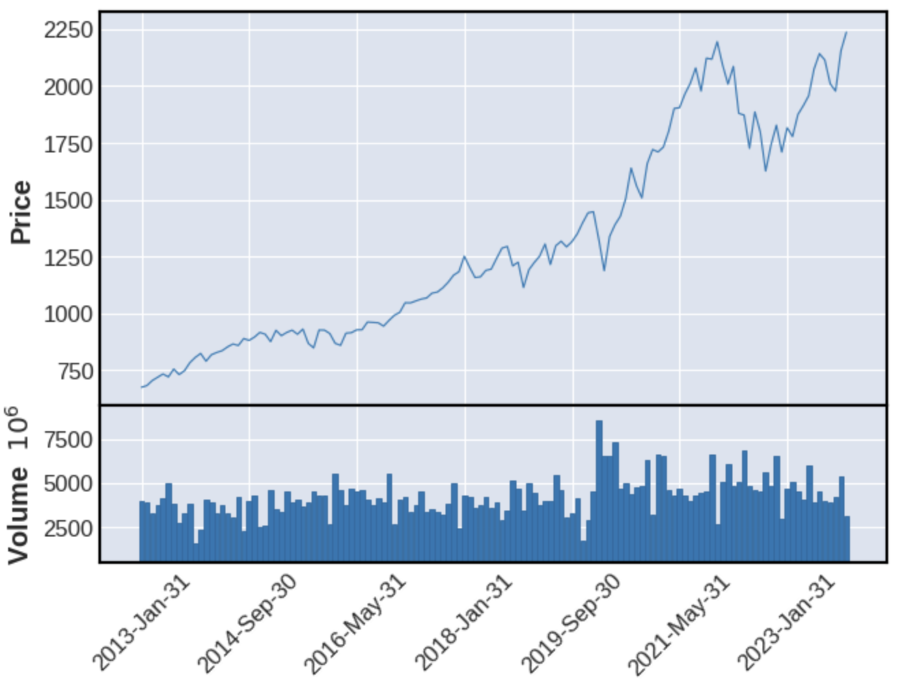
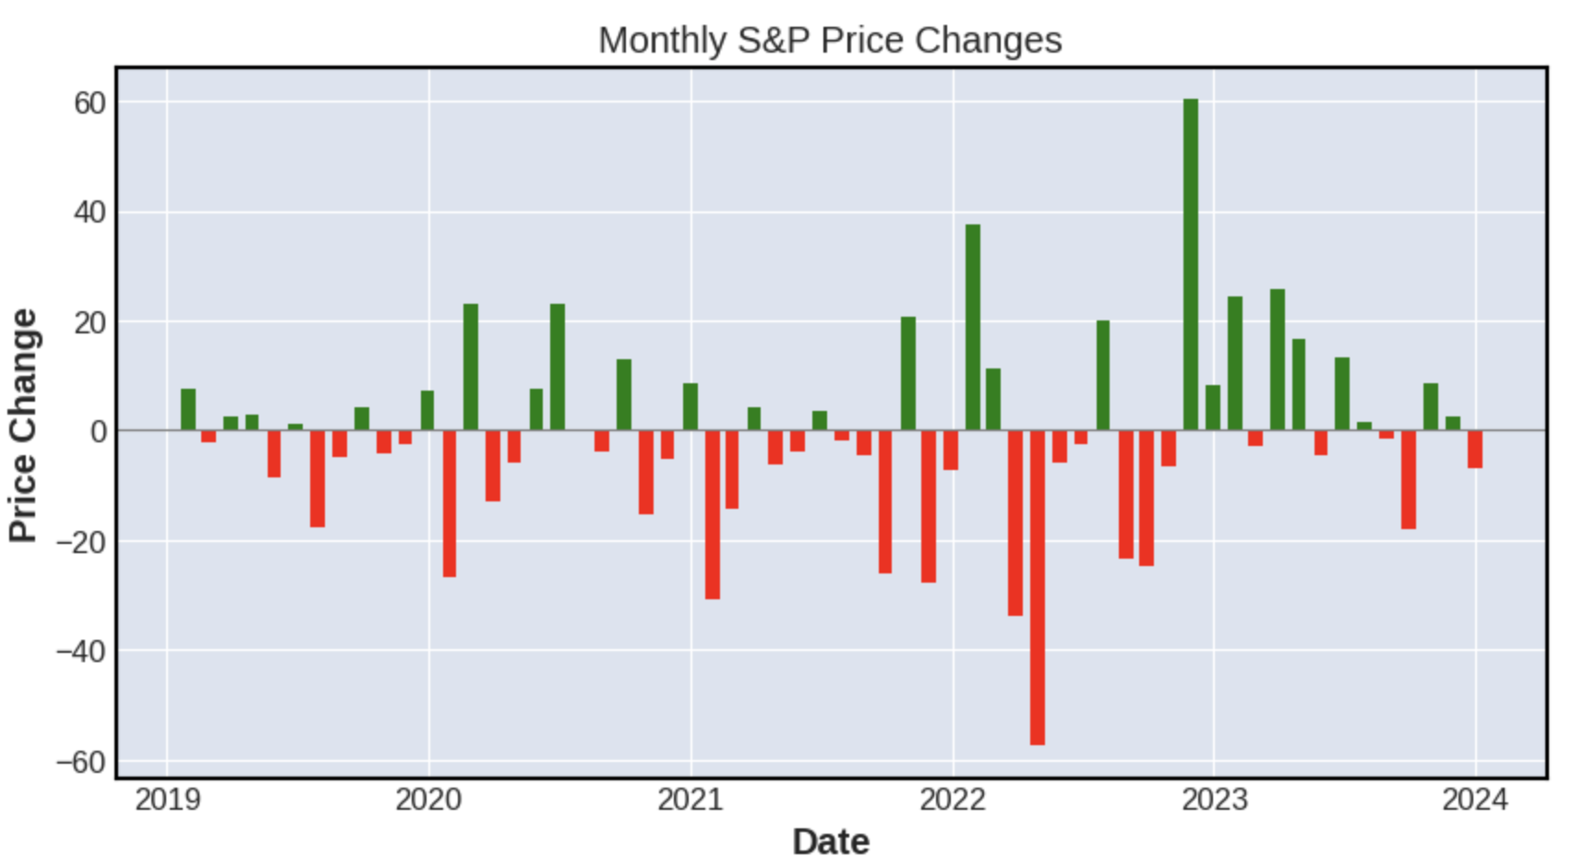
Exploratory Data Analysis
Figure 3: S&P 100 short term price change
Figure 2: S&P 100 long-term index trend
Notes:
For exploratory data analysis, we had a brief look on the historical trends on the volume and closing prices of the market index. We can observe a pretty strong performance for the stocks, especially after 2019, the blue bars below the line chart indicates the monthly volume and we can observe a subsequent increase during the upward momentum period. However, if we look closely at recent period, the covid period seems to have a big impact on the monthly price fluctuation. And we have yet to find out its impact on our strategy performance.

Slide 6
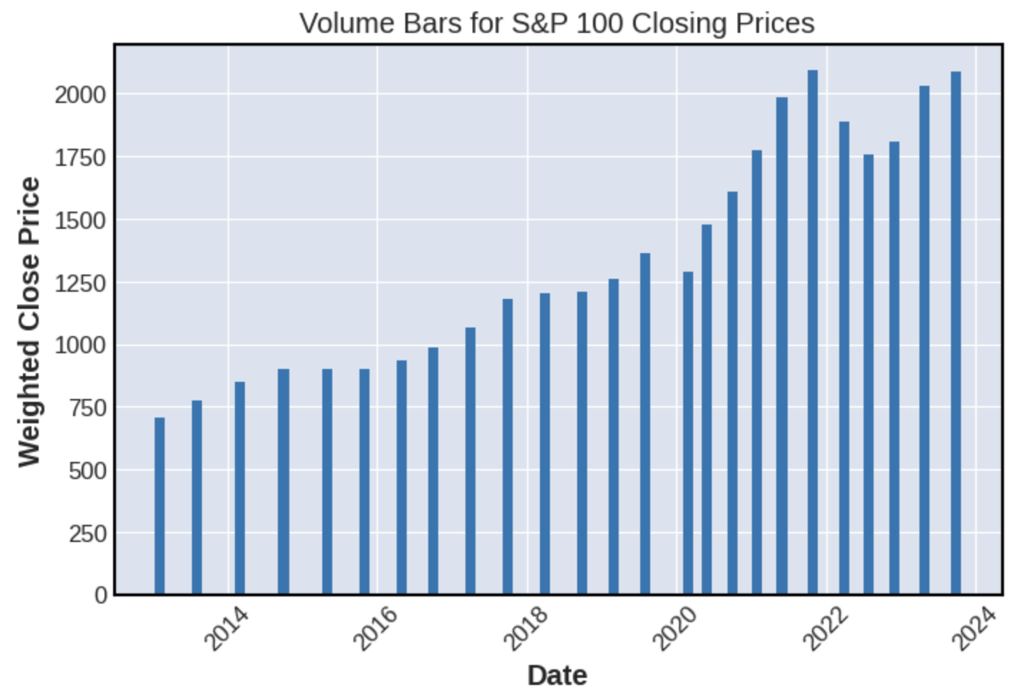
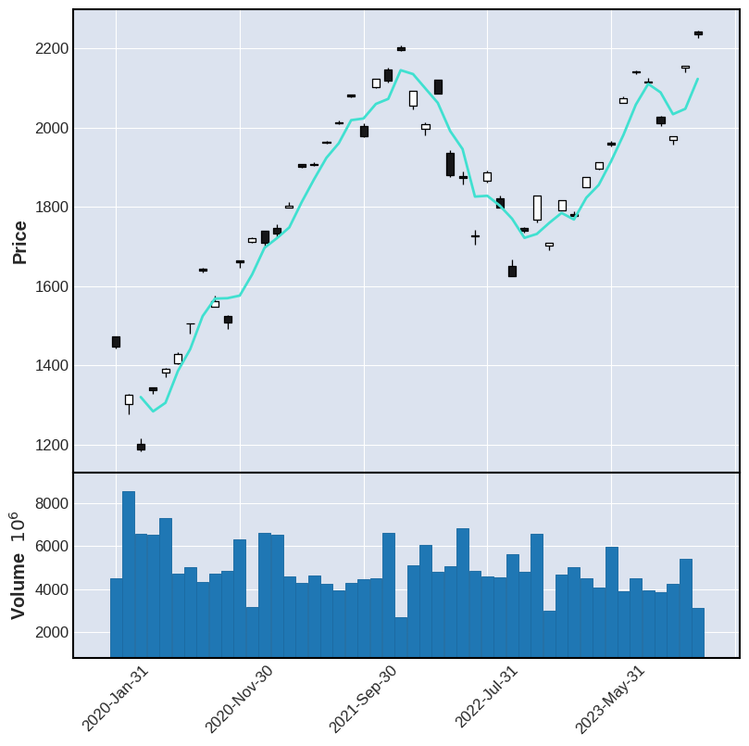
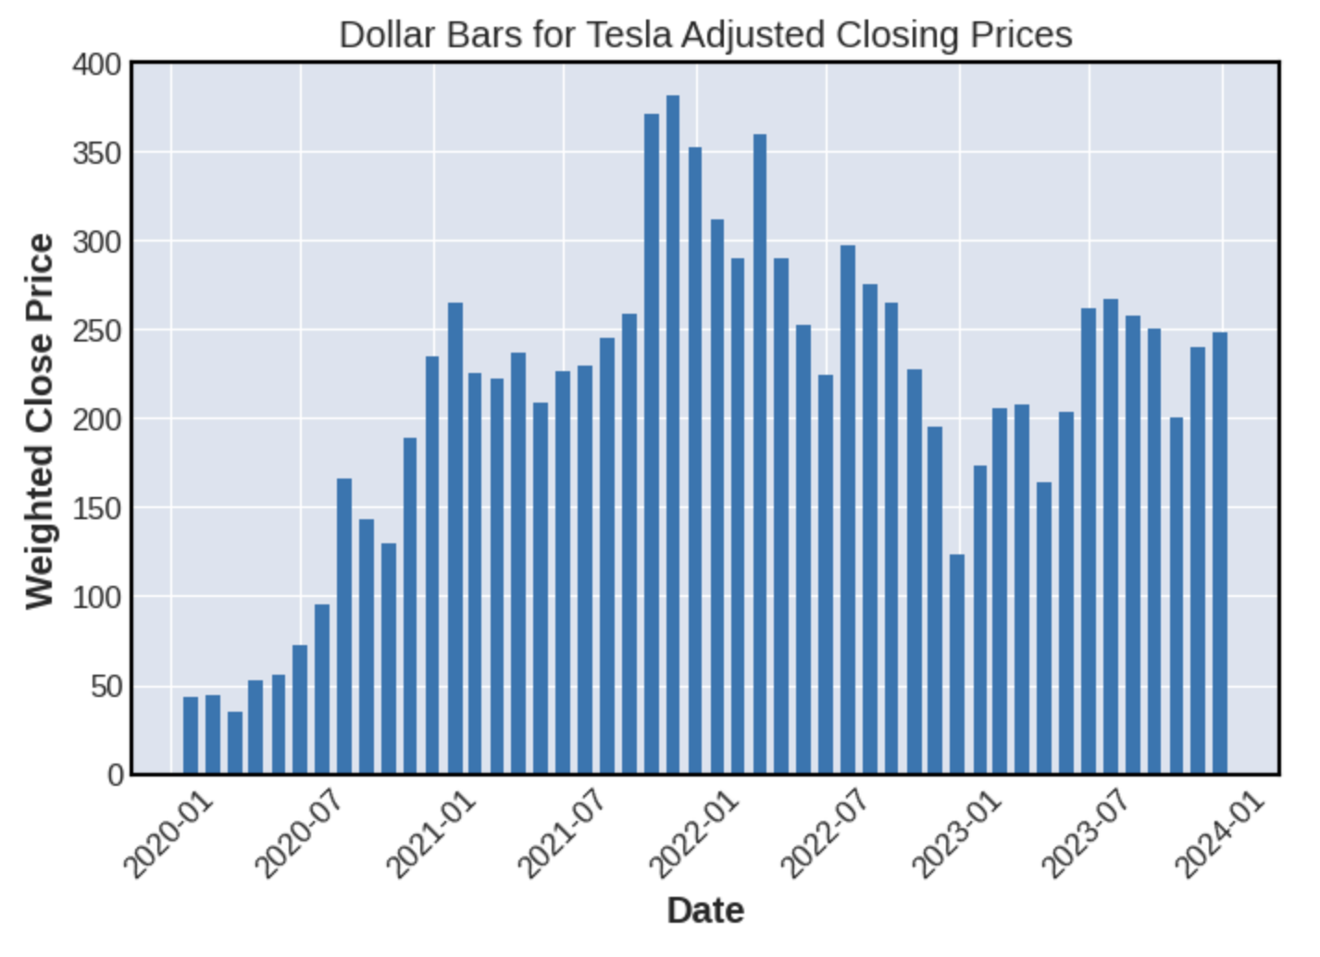
Bar Data
Figure 5: S&P 100 Volume bars
Figure 4: S&P 100 past 4 years trend
Figure 6: Tesla recent Dollar bars
Notes:
We have come up with some bar plots for better visualization. The candlestick on the left shows the trend for the index in the past 4 years and we clearly observe its fluctuation. However, since time bars have discrepancies when representing the market, we have opted to look at the volume bars and dollar bars. The volume bars on the top right shows an upward trend in recent period, indicating a higher market participation, potentially caused by post-covid period volatility, suggesting an easier change of market trends. We have also looked the Tesla in particular, which is the top stock traded in terms of volume within the index. The Tesla dollar bars at the bottom right indicates a peak of at the end of 2021, which will certainly have an impact on our strategy. Fixing volume and dollar value traded per bin can increase the statistical representation power of the market, catering factor like stock splits, order and information arrival, which might help understand the distribution of price change better.

Slide 7
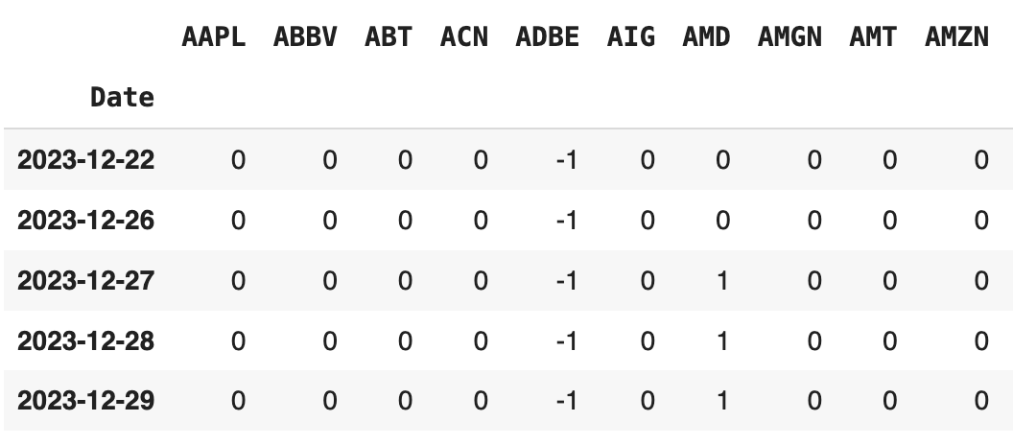
Technical Analysis Techniques
Technical analysis
Assume historical pattern upholds in the future
Use nlargest function to identify top 10 stocks with largest n month return
Apply same technique on negative returns to get worst performers
Generate buy signal (+1) for top stocks
Generate sell signal (-1) for worst stocks
Returns are computed based on rolling window of parameter choice: Length of ranking period
Table 2: Trading Signal Construction
Notes:
In terms of technical analysis techniques: We are assuming historical patterns uphold in the future. Therefore, we use the nlargest function in python to identify top 10 stocks with the largest n month return. The same technique is also applied on negative returns to get the worst performers. We can then generate a buy signal of +1 and sell signal of -1 for the corresponding stocks. Returns are then computed based on rolling window of parameter choice, in which we can choose the length of the ranking period in terms of number of months

Slide 8
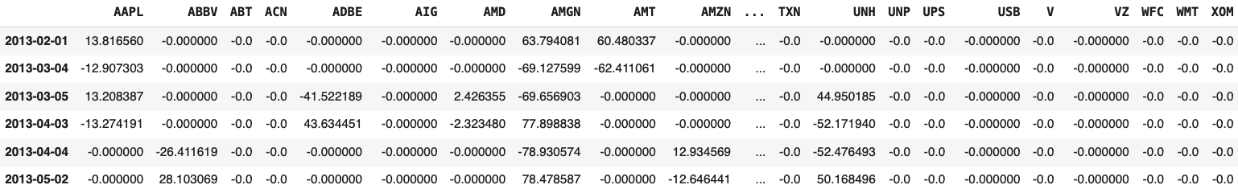
Trading Strategy Development
Assumptions
Trade size: 1 share
Trade price: Adj Close
Negative Slippage: 15 bps [2]
Signal Construction
Compute R-month returns at every trading day (R = length of ranking period)
Sample every H month and compute rankings to trigger buy/sell signal (H = length of holding period)
Trade Execution
Based on buy/sell signal, create corresponding offset/liquidation trades the day before the next sampled holding date (i.e, buy @ t corresponds to sell @ t + holding period - 1)
Align with stock prices at trading dates
Calculate and aggregate market friction adjusted realized PnLs at every trading day
Table 3: Daily realized PnL by stocks with ranking & holding periods of 1 month each
Notes:
Eric

Slide 9
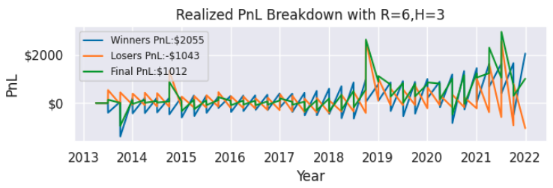
Backtesting
Backtesting periods
Training period: 2013-01-01 to 2021-12-31
Testing period: 2022-01-01 to 2023-12-31
Realized PnLs breakdown
Winners PnL: Realized PnL from the long positions of the dynamically ranked top 10 stocks with highest returns
Losers PnL: Realized PnL from the short positions of the dynamically ranked bottom 10 stocks with lowest returns
Total PnL = Winners PnL + Losers PnL
Figure 7. Cumulative Realized PnLs of Momentum Strategy with 6-month ranking & 3-month holding period
Notes:
Eric

Slide 10
Performance Metrics
Metrics from paper
Cumulative PnL
Raw returns
Excess returns
Market Friction(handled earlier)
Systematic Risk
Added metrics
Winners/Losers/Overall volatility
Max Drawdown
Sharpe Ratio
Sortino Ratio
Notes:
Mark

Slide 11
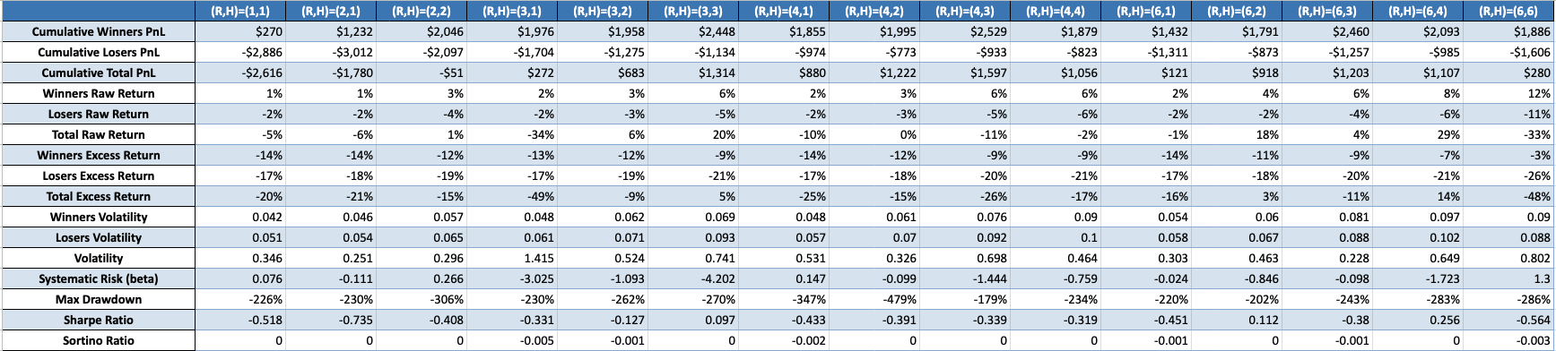
Sensitivity Analysis
Parameters Combinations
(R,H) = (length of ranking period in months, length of holding period in months)
R >= H
Metrics are all annualized except for cumulative raw PnLs
Performance Metrics during training period of different ranking & holding periods
Notes:
Eric

Slide 12
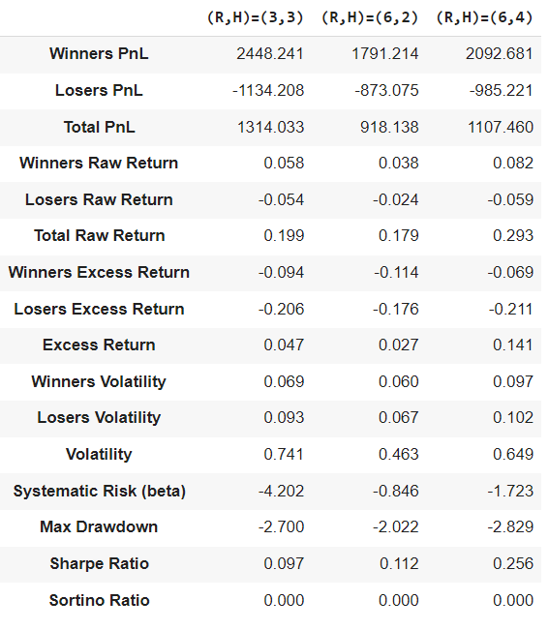
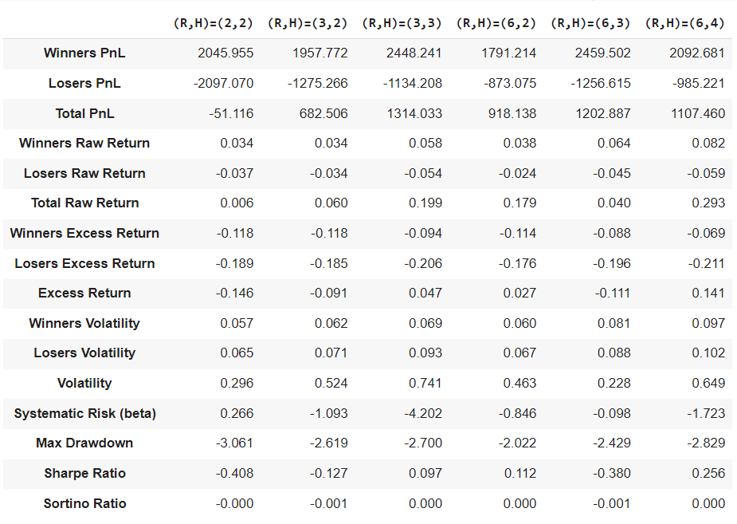
Optimization
Different ranking period(Rs) and holding period(Hs) to evaluate strategy performance
Highest profitability: highest total PnL
Risk-adjusted return: highest Sharpe ratio
Lowest risk
lowest total volatility
lowest maximum drawdown
Overall: Positive raw return, excess return and highest Sharpe ratio
Notes:
Mark

Slide 13
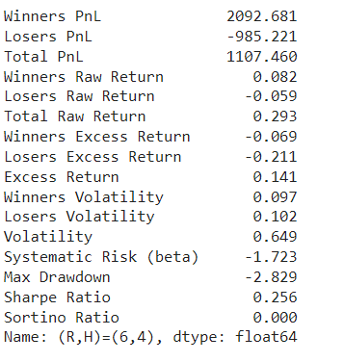
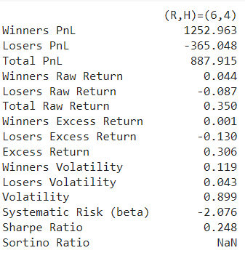
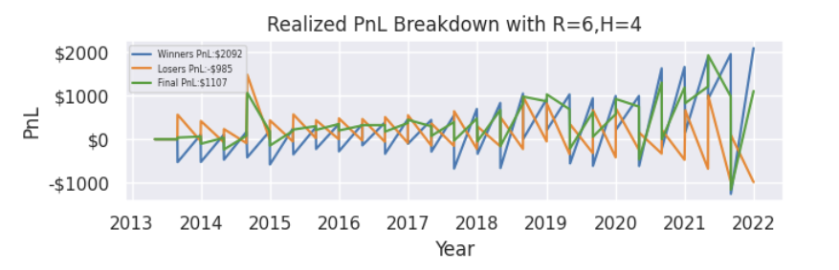
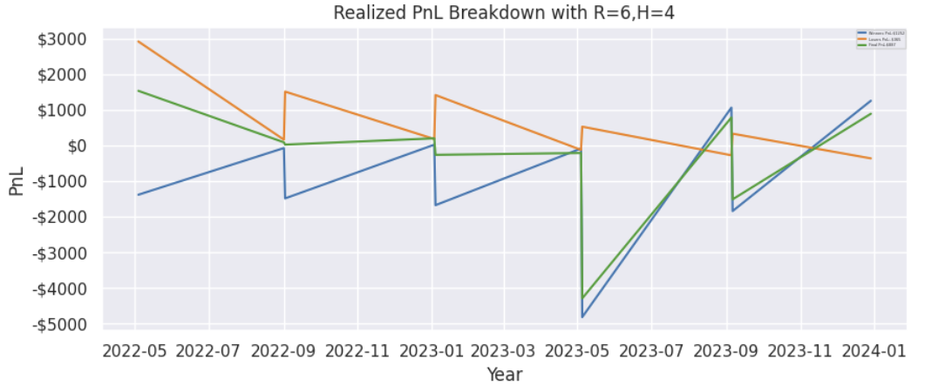
Results with R=6, H=4
On training data
On testing data
Realized PnL for best param during training period
Realized PnL for best param during testing period
Notes:
Mark(cumulative pnl chars, metrics for the testing period for best Rs and Hs)

Slide 14
Conclusion and Limitations
Strategy is semi-successful in generating profits by utilizing historical returns as a momentum indicator
Profit is attributed to winners (i.e, long positions in stocks with large short-term returns)
Negative excess returns indicates its failure to beat the market
Limitations
Fails to provide consistent average annual returns
Lack of an upward drift in the cumulative PnL chart as seen in results section
Short positions fail to generate PnL
Large annual returns volatility
Fails to address the mean reversion nature of the assets
When a stock has high short-term historical returns, it tends to move back down; vice versa
Future Recommendations
Consider only taking on long positions from winners
Consider incorporating the mean reversion nature of stocks
Consider imposing risk limits in the forms of trading notional/volume constraints

Slide 15
Implementation
Separate into 4 processes: signal construction, order execution, risk monitoring, and trade parameters optimization
Signal construction: constructs buy/sell signals based on rolling R-day rankings of stocks returns
Order execution: sends buy/sell orders to the market and ensures they are filled properly
Risk monitoring: keeps track of unrealized PnLs during holding period and impose risk constraints for position unwinding if they are violated
Trade parameters optimization: dynamically optimize model parameters at the end of every holding period (i.e, trade volume, risk constraints, etc)

Slide 16
References
[1] Momentum: Simple Trading Strategies Part 2; https://medium.com/auquan/momentum-simple-trading-strategies-part-2-188cf464ffcf
[2] Market friction assumption: https://www.bloomberg.com/professional/insights/trading/buy-side-equity-trading-costs-ease-through-2022/

